Slide 1
Climate predictive Analysis
Group Members
Muhammad Salman
Usman Zafar
Syed Faseeh
Class
BS Artificial intelligence
Semester 4th
Section Morning A

Slide 2
The Problem
An IOT Project for Live and Future Weather Forecasting based on Machine Learning Techniques

Slide 3
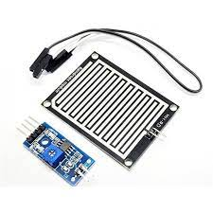

Tools And Material Used
Hardware
Arduino Uno
DHT11 Temperature and Humidity Sensor
BMP180 Pressure Sensor
Rain Sensor

Slide 4




Tools And Material Used
Other Tools
Arduino IDE
Python
VS code
Jupyter Notebook
My SQL Server
Xampp Control Panel
phpMyAdmin
Languages and Libraries Used
Python
C++
SQL
Pyserial
MySQL-Python

Slide 5
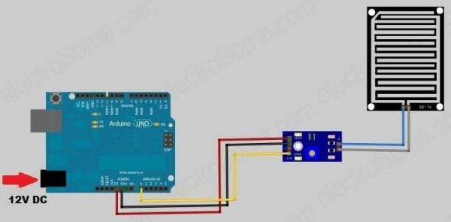
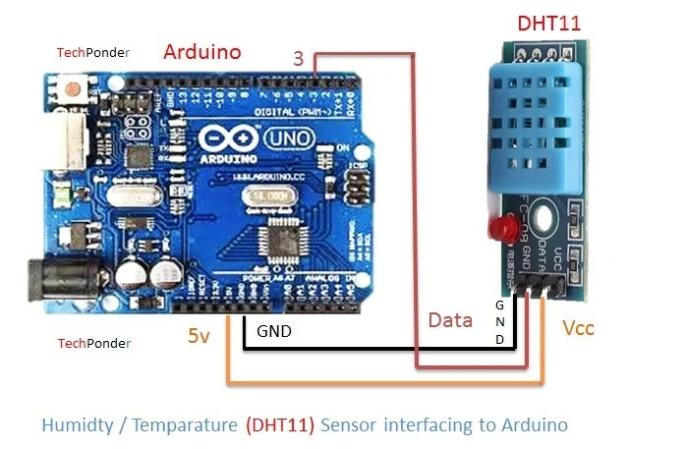
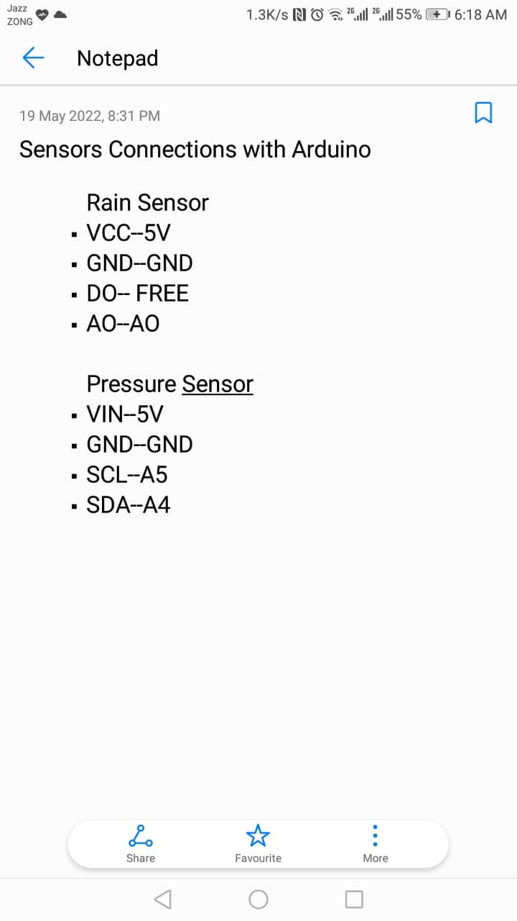

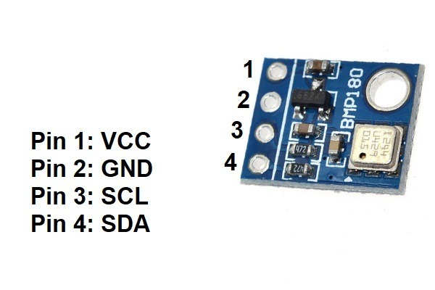
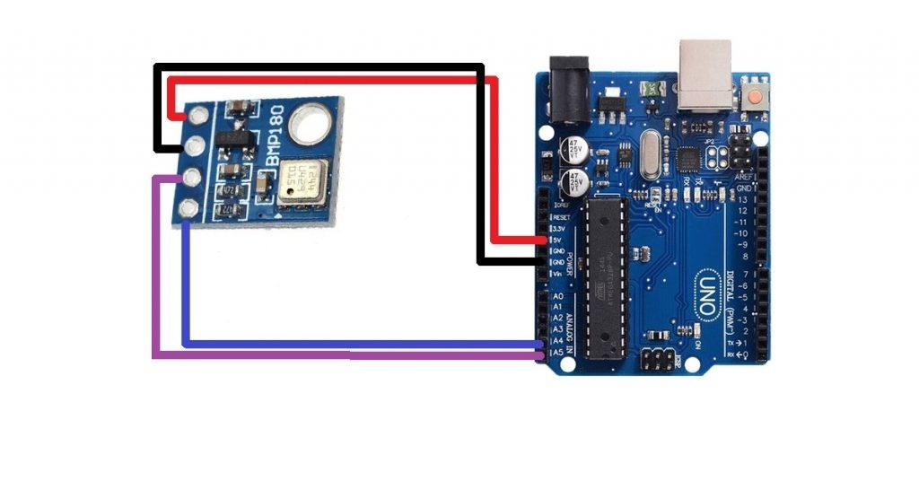
Connections to Arduino

Slide 6
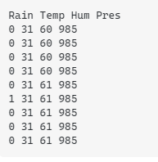
Data from Arduino
Raining → 1 | Not raining → 0
Temperature in Celsius(C)
Humidity percentage(%)
Pressure in hectoPascal(hPa)

Slide 7
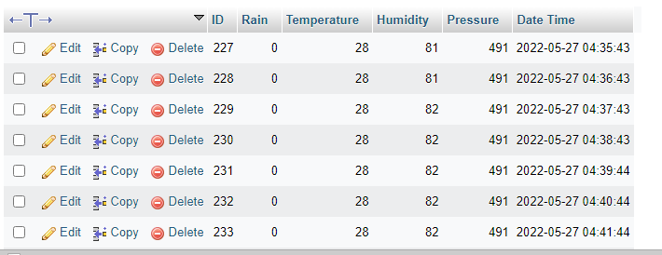
Data On MySQL Database
Example data sent from Arduino after every minute

Slide 8
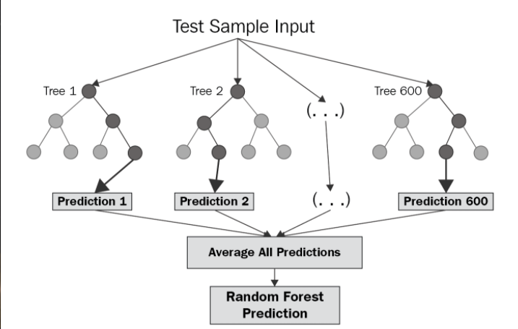
Random Forest Regression Algorithm for Predictions
Random Forest Regression is a supervised learning algorithm that uses ensemble learning method for regression.
Ensemble learning method is a technique that combines predictions from multiple machine learning algorithms to make a more accurate prediction than a single model.

Slide 9
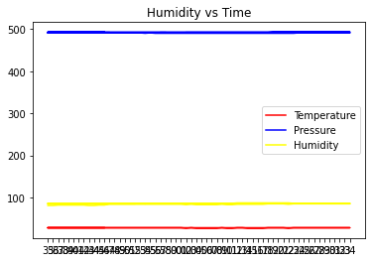
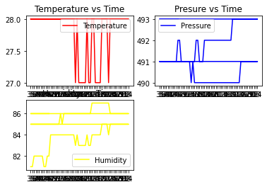
Graph Of Original Data

Slide 10
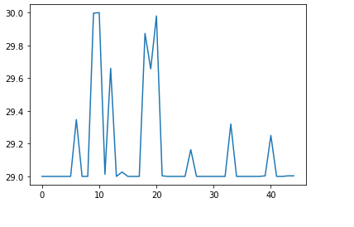
Graph Against Minutes And Temperature Predicted

Slide 11
Thanks
Group Members
Muhammad Salman
Usman Zafar
Syed Faseeh

